Slide 1

graph search
Kaiser sakhi

Slide 2

What is it?
Graph traversal (also known as Graph search) refers to the process of visiting (checking and/or updating) each vertex in a graph.
src : Wikipedia

Slide 3
How to do it?

Slide 4
How to do it?

Slide 5
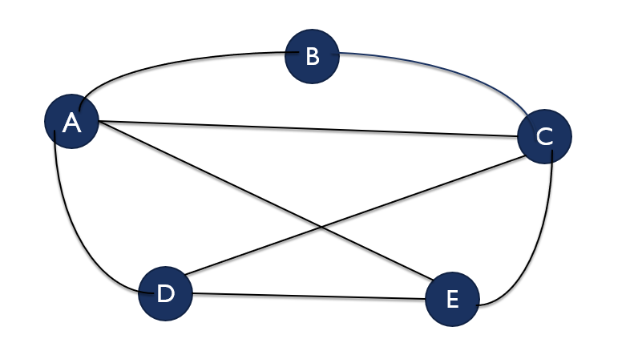
The problem!
Imagine, you have to visit 5 friends in five cities

Slide 6

The catch!
You are Ghajini

Slide 7
The problem!
You have to visit 5 friends in five cities.
You don’t remember a thing.
How would you visit every friend?

Slide 8

Visiting the friends :ghajni approach

Slide 9
Visiting the friends :ghajni approach

Slide 10
Visiting the friends :ghajni approach

Slide 11
Visiting the friends :ghajni approach

Slide 12
The problem’s with the ghajni approach
You might not visit every friend
OR worst you can get stuck in an infinite loop

Slide 13
We need a systematic solution

Slide 14
We need a systematic solution
Solution first = ‘007’ visit

Slide 15
The 007 approach

Slide 16
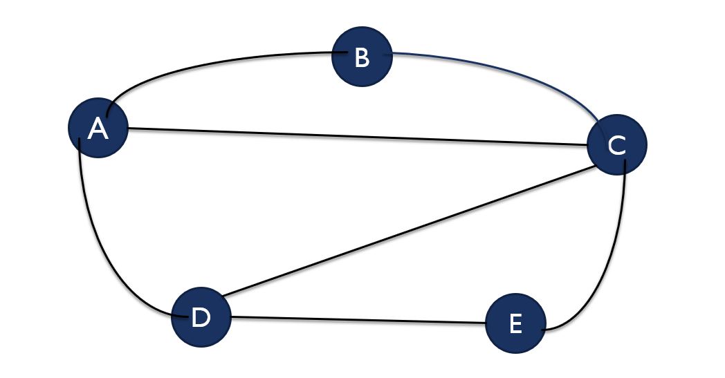

The 007 approach

Slide 17

The 007 approach

Slide 18
The 007 approach

Slide 19

The 007 approach

Slide 20

The 007 approach

Slide 21

The 007 approach

Slide 22

The 007 approach

Slide 23
The 007 approach

Slide 24
The 007 approach

Slide 25

The 007 approach

Slide 26
The 007 approach
I’m going to
Visit city ‘E’ now

Slide 27
The 007 approach

Slide 28

The 007 approach

Slide 29
The 007 approach

Slide 30

The 007 approach

Slide 31
The 007 approach

Slide 32
The 007 approach

Slide 33
The 007 approach
Ghajini Visited each and every friend with 007 Approach

Slide 34
a systematic solution
Solution second = ‘Butterfly’ visit

Slide 35
The Butterfly approach

Slide 36
The Butterfly approach

Slide 37
The Butterfly approach

Slide 38
The Butterfly approach

Slide 39
The Butterfly approach

Slide 40
The Butterfly approach

Slide 41
The Butterfly approach

Slide 42

The Butterfly approach

Slide 43

The Butterfly approach

Slide 44

The Butterfly approach

Slide 45

The Butterfly approach

Slide 46

The Butterfly approach

Slide 47
Stop and think!
What is the difference between 007 and Butterfly?

Slide 48
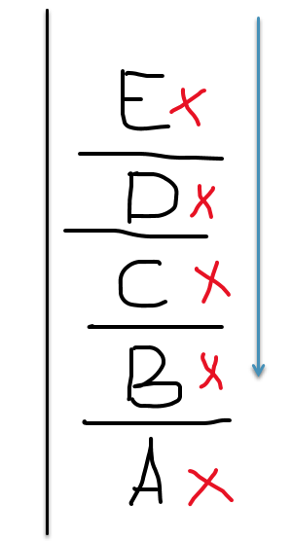
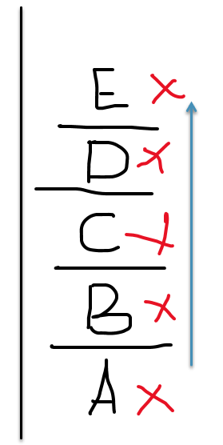








007 & butterfly

Slide 49
007 & butterfly
The only difference between 007 and Butterfly is :
The way we chose to pick element’s
Stack Data Structure best fits for the picking of element’s for 007,
007 is commonly known as Depth First Search (DFS)
Queue Data Structure best fits for the picking of the element’s for
Butterfly , Butterfly is commonly known as Breadth First Search
(BFS)

Slide 50
Little recap!
Push an item
Pop an item
Dequeue an item
enqueue an item
Stack
Queue

Slide 51
Let’s get bit technical now
A
B
C
D
E
F
G

Slide 52
Dfs : depth first search
Stack.push(A) , its like Ghajni is look at the map and decided to start from city A
A
B
C
A
D
E
F
G
Let’s start from node A
Stack

Slide 53
Dfs : depth first search
Mark A as visited
Who are adjacent to node A
B
A
B
C
A
D
E
F
F
G
A
Now, we’ll start the repeating procedure
Stack.pop(A), we have node A in our hand now
Stack

Slide 54
Dfs : depth first search
A
Stack.push(F , B)
B
A
B
C
A
D
E
F
F
G
Note : Order doesn’t matter here, you push F first or B
Stack

Slide 55
Dfs : depth first search
Step 2 : Mark Popped Node
Step 3: Push adjacent node in the stack
A
B
C
A
D
E
F
G
F
E
F
G
B
Repeat Previous Step,
Step 1 : Stack.pop()
Stack

Slide 56
Dfs : depth first search
F
Step 2 : Mark Popped Node
Step 3: Push adjacent node in the stack
A
B
C
A
D
E
F
G
E
F
G
B
Repeat Previous Step,
Step 1 : Stack.pop()
Stack

Slide 57
Dfs : depth first search
Step 2 : Mark Popped Node
Step 3: Push adjacent node in the stack
A
B
C
A
D
G
E
F
E
F
G
B
Repeat Previous Step,
Step 1 : Stack.pop()
Stack

Slide 58
Dfs : depth first search
G
Step 2 : Mark Popped Node
Step 3: Push adjacent node in the stack
B
C
A
C
A
D
E
F
E
F
G
B
Repeat Previous Step,
Step 1 : Stack.pop()
Stack

Slide 59
Dfs : depth first search
Step 2 : Mark Popped Node
Step 3: Push adjacent node in the stack
C
A
B
C
A
D
D
C
E
F
E
F
G
B
Repeat Previous Step,
Step 1 : Stack.pop()
Stack

Slide 60
Dfs : depth first search
C
Step 2 : Mark Popped Node
Step 3: Push adjacent node in the stack
C
A
B
C
A
D
D
E
F
E
F
G
B
Repeat Previous Step,
Step 1 : Stack.pop()
Stack

Slide 61
Dfs : depth first search
Step 2 : Mark Popped Node
Step 3: Push adjacent node in the stack
C
A
B
C
A
D
D
D
E
F
E
F
G
B
Repeat Previous Step,
Step 1 : Stack.pop()
Stack

Slide 62
Dfs : depth first search
Step 2 : Mark Popped Node
Step 3: Push adjacent node in the stack
C
A
B
C
A
D
D
E
F
E
E
F
G
B
Repeat Previous Step,
Step 1 : Stack.pop()
Stack

Slide 63
Dfs : depth first search
Step 2 : Mark Popped Node
Step 3: Push adjacent node in the stack
C
A
B
C
A
B
D
D
E
F
E
F
G
B
Repeat Previous Step,
Step 1 : Stack.pop()
Stack

Slide 64
Dfs : depth first search
Stack is empty at this point, that means we have visited all the node.
Stop! We are done with the algorithm.
Stack

Slide 65
BFS : Breadth first search
A
B
C
D
E
F
G
Queue

Slide 66

Thank You
Github.com/kaisersakhi

